Slide 1
Rietveld Refinement of HB-2A Data Using FullProf Software
HB-2A Instrument Team
High Flux Isotope Reactor
July 2017

Slide 2
Starting Requirements
FullProf Software: https://www.ill.eu/sites/fullprof/php/downloads.html
Click the link and follow the instructions to download the specific version for your computer
Your Data File (.dat): Please see User Guides for Experiment HB-2a to obtain your experimental data
“Data Reduction Instructions”
This tutorial uses the Ge115 Silicon standard located in Experiment 535 on Grafiti for HB-2A data.
Crystallographic Information File (.cif) for your crystal structure from ICSD (Skip the last two bullets if you downloaded the files with the tutorial)
Wavelength used for your experiment

Slide 3
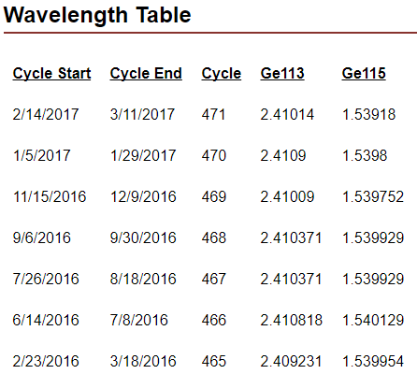
Finding the Wavelength
Each cycle the wavelength varies slightly so it is important to retrieve the current wavelength from the HB-2A website
Be aware that there are two choices for wavelength, make sure you have the correct one! (Ge113 or Ge115)
https://neutrons.ornl.gov/powder/users
Scroll to the Wavelength Table
This tutorial is refining the silicon standard for
cycle 471 (Ge115)
Therefore the wavelength is 1.53918 Å

Slide 4
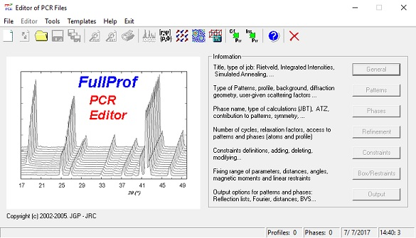
Import Your .cif to EDPCR
Click “EDPCR”
Click Cif->PCR

Slide 5
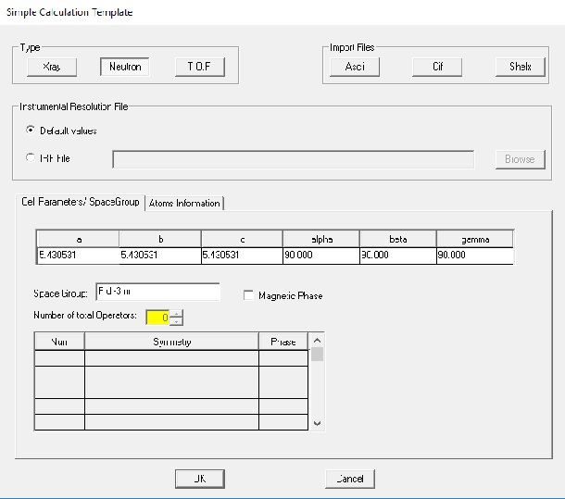
Tip: Change the name of your CIF file to be the same as your DAT file
3. Open your data
4. Select “Neutron” and press “OK”

Slide 6
Work Through the Tabs
At this point you must work through all of the tabs. You will give the software more information and begin refining.
Select “General”

Slide 7
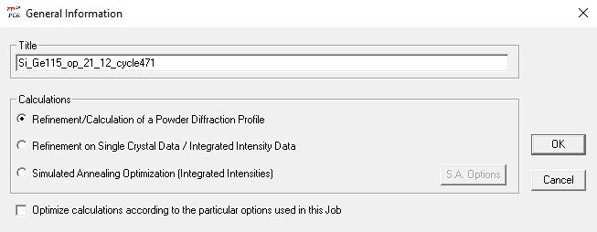
Insert a title for your refinement
Press “OK”
Select “Patterns”

Slide 8
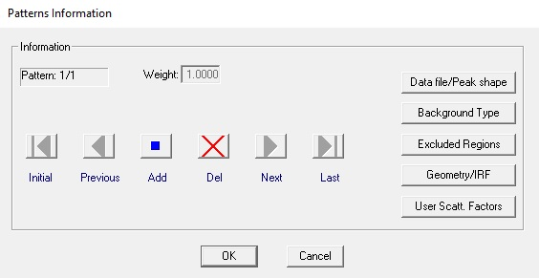
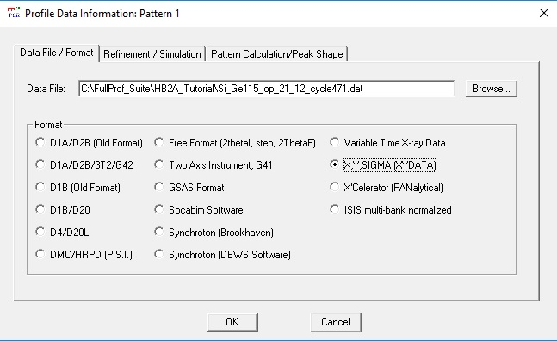
Select “Data file/Peak shape”
Ensure the Data File selected is the data for your
experiment.
Select “X,Y,Sigma (XYDATA)” for the data Format
Then select “Refinement / Simulation at the top

Slide 9
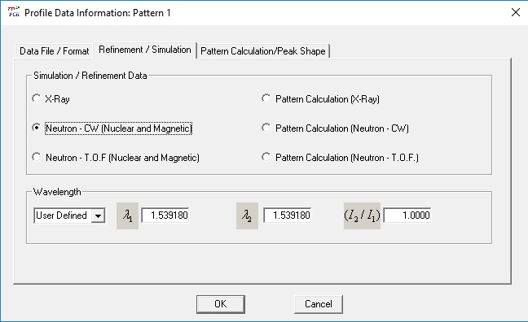
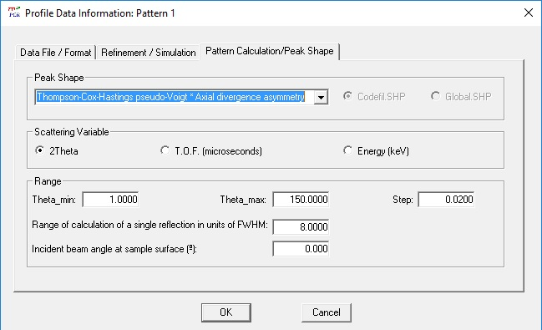
Select “Neutron – CW (Nuclear and Magnetic)”
Change the Wavelength input to “User Defined”
Change λ₁ and λ₂ to “1.539180” (retrieved previously)
and (I₂/I₁) to 1.
Select “Pattern Calculation/Peak Shape” at the top
Change Peak Shape to “Thompson-Cox-Hastings
Pseudo-Voigt * Axial divergence asymmetry”
Press “OK”

Slide 10
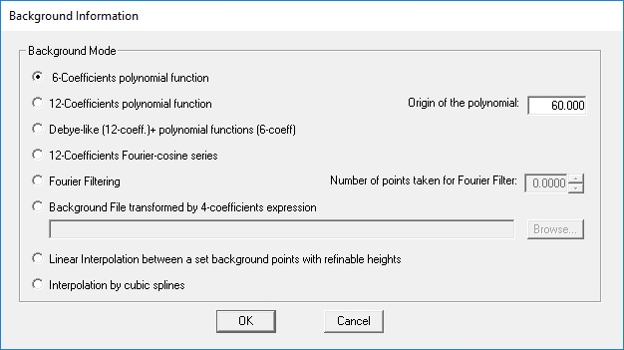
Select “Background Type
Select “6-Coefficients polynomial function”
Change the value of “Origin of the polynomial” to 60
Press “OK”

Slide 11
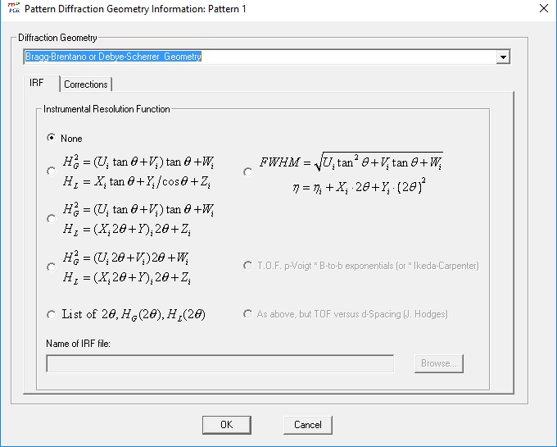
Select Geometry/IRF
Select “Bragg-Brentano or Debye-Scherrer Geometry” for Diffraction Geometry
Select “Corrections”

Slide 12
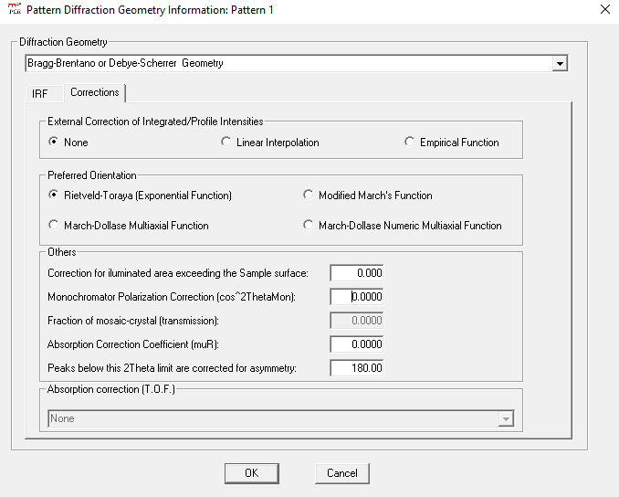
Change “Monochromator Polarization Correction” to
0.
Change “Peaks below this 2Theta…” to 180.00
This will allow all peaks to be corrected for
asymmetry. If not changed from 0, an error will
occur when refining asymmetry parameters.
Press “OK” twice and return to EDPCR

Slide 13
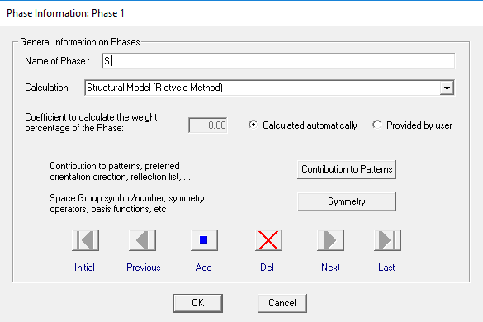
Select “Phases”
Name your phase
Select “Contribution to Patterns”

Slide 14
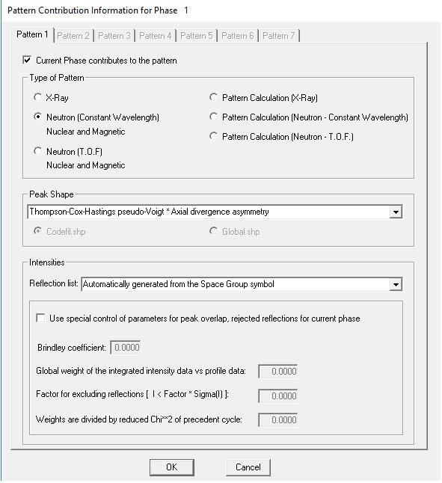
Select “Neutron (Constant Wavelength) Nuclear and
Magnetic” for Type of Pattern
Select “Thompson-Cox-Hastings pseudo-Voigt * Axial
Divergence asymmetry” for Peak Shape
Press “Ok” twice and return to EDPCR

Slide 15
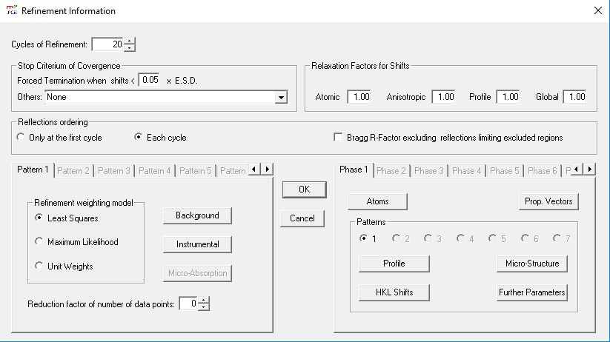
Refinement
Press the save button. This updates the .pcr file. Be sure
to press save each time you adjust your refinement
parameters.
Select “Refinement”
Change the Cycles of Refinement to “20”
Change the Forced Termination when shifts < to “.05”
Under Reflections ordering select “Each cycle”
Select “Profile”

Slide 16
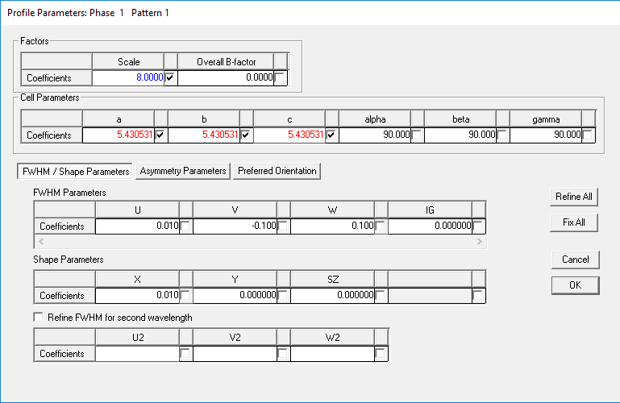
A typical refinement may begin by selecting
“Scale”, and cell parameters “a”, “b”, and “c”
Change the scale to a reasonable value.
Here the value was changed to 12 to begin. Select an option for refinement by clicking the checkbox next to the value.
Change the values of U, V, W, and X to 0.1, -0.1, 0.1, and 0.01 respectively. Typically these values are refined in later cycles
When you are satisfied with your selection
press “OK” twice and return to the EDPCR
window.

Slide 17
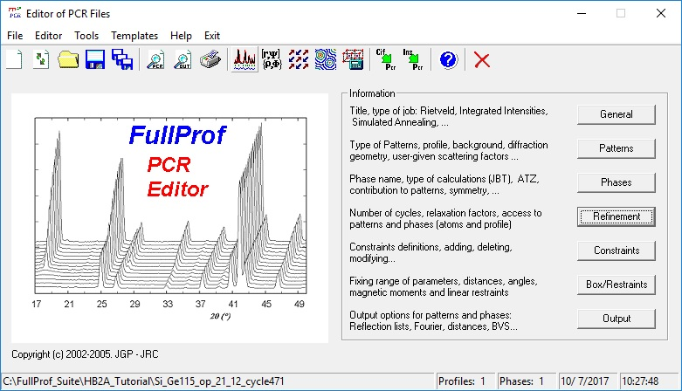
Press save to update the .pcr file.
Run FullProf to begin refinement

Slide 18
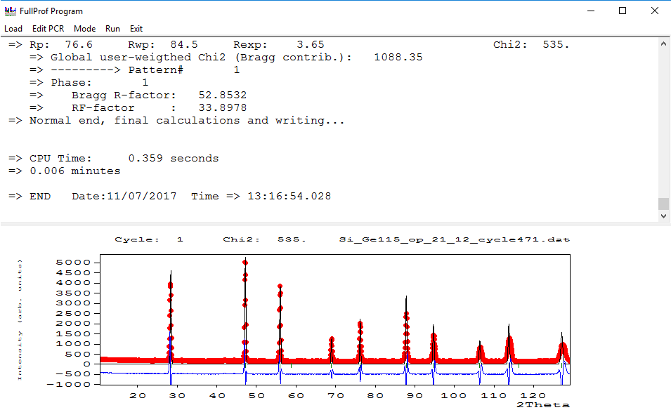
After clicking run FullProf
you will see this screen.
Here you can see statistics
at the end of each cycle in the
top window.
In the bottom window you can
see a graphical representation
of the refinement. The red is
Observed, the black is
Calculated and the blue is
(Observed – Calculated)
Left click on the plot and
zoom in on a portion of the
background

Slide 19
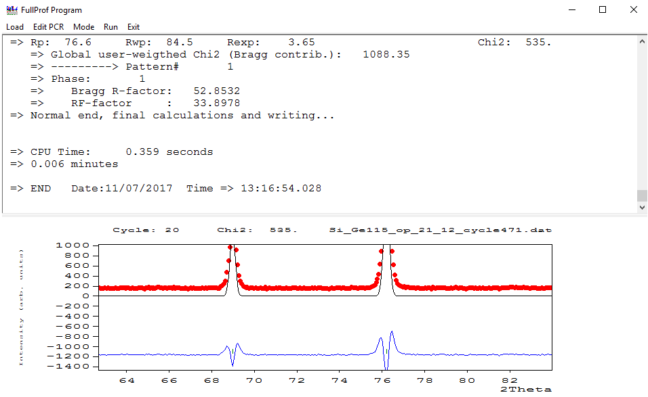
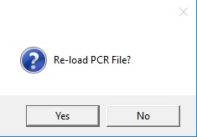
HB-2A has a relatively flat background. Zooming in
on the plot can give an estimate for the zero-order factor
of the 6-degree polynomial. For the pattern, “175”
is a good starting point.
Also, you can observe a great deal of asymmetry on the
two visible peaks. This too will need to be corrected for.
At this time, close out of the FullProf program
When you close out, EDPcr will ask if you would like to re-load the
PCR File. Select Yes if are satisfied with the result of the refinement.
Select no otherwise. You may want to select no if your refinement
diverges or if your refinement affects the calculated values adversely.

Slide 20
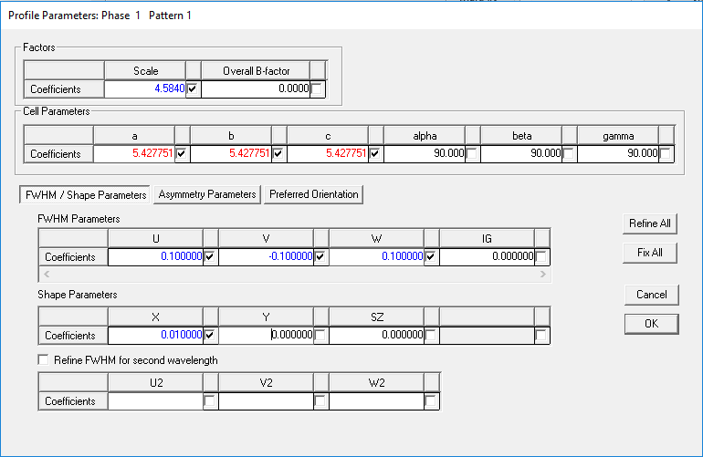
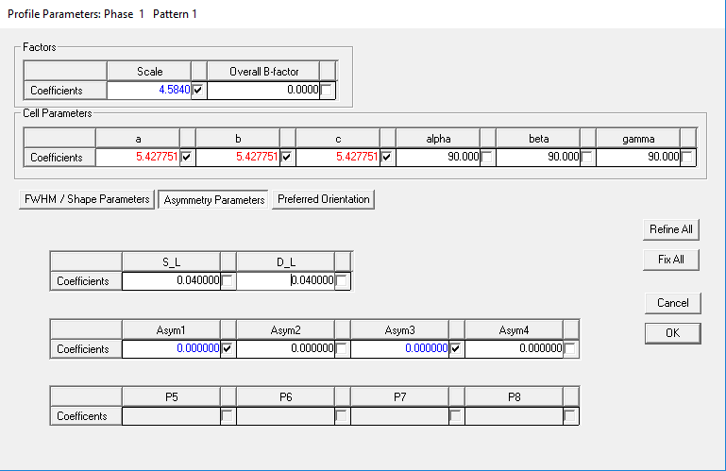
Return to the Profile Parameters Refinement window. Add U, V, W, and X to be refined
*Do not refine IG, Y or SZ on HB-2A data*
Select “Asymmetry Parameters”
Set S_L and D_L to .04
Select Asym1 and Asym3 for refinement.
Press “OK”

Slide 21
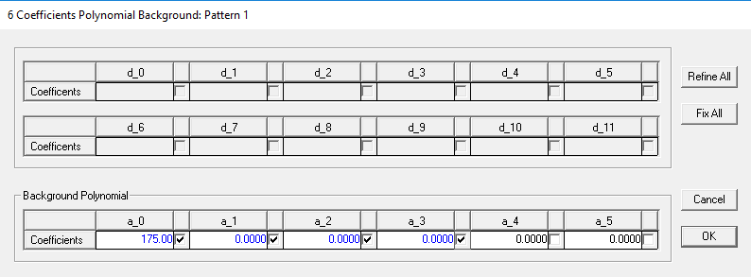
Select “Background”
Change a_0 to 175 (Mentioned earlier)
Check the box for refinement for the first for coefficients
Press “OK” twice and return to EDPCR

Slide 22
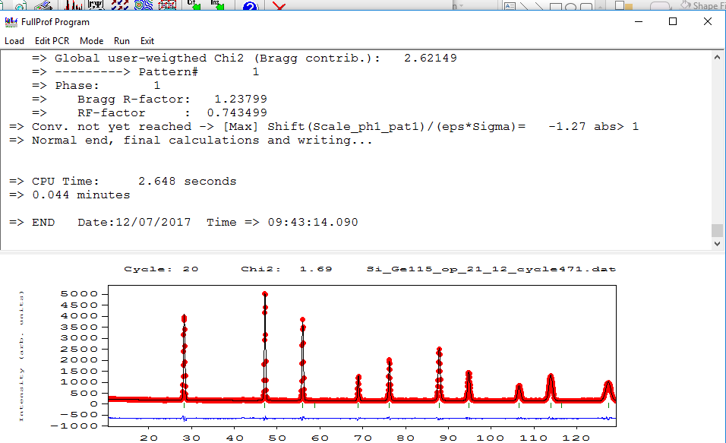
Press save and run FullProf
After a couple of runs, the Chi2 value has improved considerably, but there is still work to do. Close FullProf and return to EdPCR

Slide 23
Finishing the Refinement
Add the remaining background coefficients
Add the remaining 2 asymmetry parameters and refine (Run FullProf)

Slide 24
Refine Instrumental 0
Select “Instrumental” on the Refinement Information Tab
Select “Zero” to be refined

Slide 25
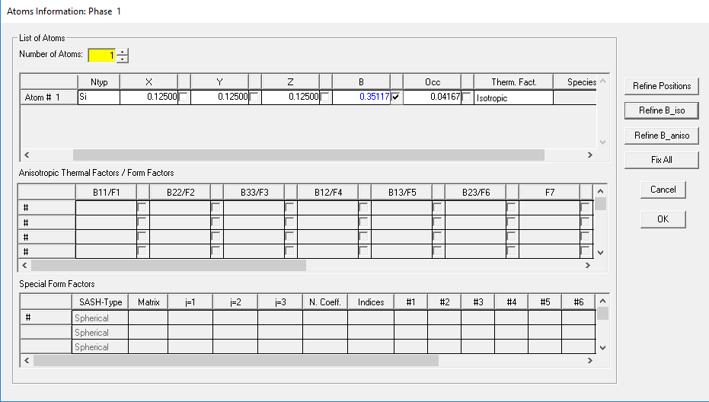
Refine Atomic B Value
Select “Atoms”
Select “B” to be refined.

Slide 26
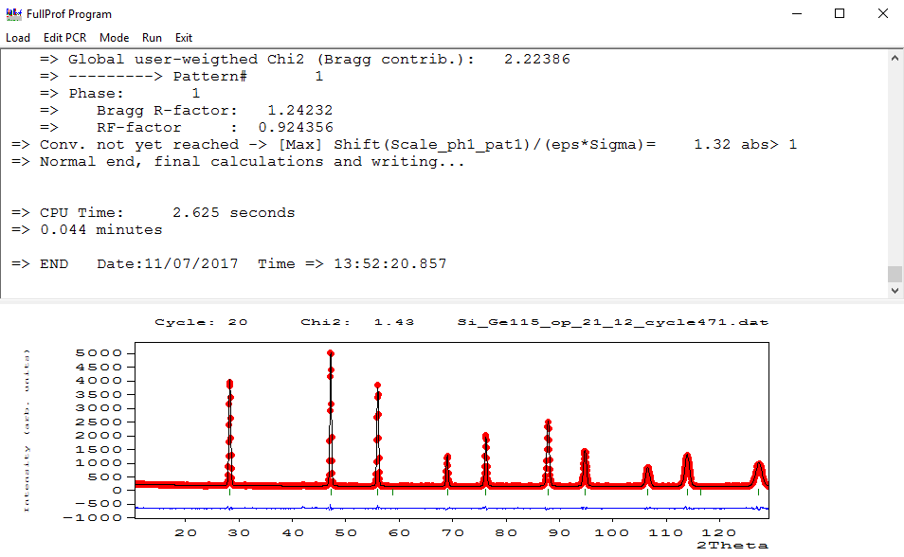
Continue working until you are satisfied with the
result of the refinement. A Chi2 of 1.43 is obtainable refining the values mentioned in this tutorial.

Slide 27
In summary
Begin refinement refining the parameters which make the largest impact on fit (Scale, lattice parameters)
Refine background and asymmetry next
Refine zero point and B value last
If the refinement diverges, try a different refinement order or refining fewer parameters at once

